Slide 1
OCCUPATIONAL HEALTH & SAFETY II
Occupational Health and Safety II
SPRING SEMESTER, 2024

Slide 2
JÜLİDE ZEYNEP AYDIN
Occupational Health and Safety II
METU MINING ENGINEER, B.Sc, 2000
UNIVERSITY OF ILLINOIS-CHICAGO, MBA, 2003
SERIAL ENTREPRENEUR
SOCIAL ENTREPRENEUR
INSTRUCTOR

Slide 3
Occupational Health and Safety II
Hazard Identification and Assessment
One of the "root causes" of workplace injuries, illnesses, and incidents is the failure to identify or recognize hazards that are present, or that could have been anticipated. A critical element of any effective safety and health program is a proactive, ongoing process to identify and assess such hazards.
To identify and assess hazards, employers and workers:
Collect and review information about the hazards present or likely to be present in the workplace.
Conduct initial and periodic workplace inspections of the workplace to identify new or recurring hazards.
Investigate injuries, illnesses, incidents, and close calls/near misses to determine the underlying hazards, their causes, and safety and health program shortcomings.
Group similar incidents and identify trends in injuries, illnesses, and hazards reported.
Consider hazards associated with emergency or non-routine situations.
Determine the severity and likelihood of incidents that could result for each hazard identified, and use this information to prioritize corrective actions.
Some hazards, such as housekeeping and tripping hazards, can and should be fixed as they are found. Fixing hazards on the spot emphasizes the importance of safety and health and takes advantage of a safety leadership opportunity.
Therefore, the following actions should be taken to better the hazard identification and assessment.

Slide 4
Occupational Health and Safety II
Action item 1: Collect existing information about workplace hazards
Information on workplace hazards may already be available to employers and workers, from both internal and external sources.
How to accomplish it
Collect, organize, and review information with workers to determine what types of hazards may be present and which workers may be exposed or potentially exposed. Information available in the workplace may include:
Equipment and machinery operating manuals.
Safety Data Sheets (SDS) provided by chemical manufacturers.
Self-inspection reports and inspection reports from insurance carriers, government agencies, and consultants.
Records of previous injuries and illnesses, such as OSHA 300 and 301 logs and reports of incident investigations and likewise.
Workers' compensation records and reports.
Patterns of frequently-occurring injuries and illnesses.
Exposure monitoring results, industrial hygiene assessments, and medical records (appropriately redacted to ensure patient/worker privacy).

Slide 5
Occupational Health and Safety II
Existing safety and health programs (lockout/tagout, confined spaces, process safety management, personal protective equipment, etc.).
Input from workers, including surveys or minutes from safety and health committee meetings.
Results of job hazard analyses, also known as job safety analyses.
Information about hazards may be available from outside sources, such as:
OSHA, National Institute for Occupational Safety and Health (NIOSH), and Centers for Disease Control and Prevention (CDC) websites, publications, and alerts or any other similar sources.
Trade associations.
Labor unions, state and local occupational safety and health committees/coalitions ("COSH groups"), and worker advocacy groups.
Safety and health consultants.

Slide 6
Occupational Health and Safety II
Action item 2: Inspect the workplace for safety hazards
Hazards can be introduced over time as workstations and processes change, equipment or tools become worn, maintenance is neglected, or housekeeping practices decline. Setting aside time to regularly inspect the workplace for hazards can help identify shortcomings so that they can be addressed before an incident occurs.
How to accomplish it
Conduct regular inspections of all operations, equipment, work areas and facilities. Have workers participate on the inspection team and talk to them about hazards that they see or report.
Be sure to document inspections so you can later verify that hazardous conditions are corrected. Take photos or video of problem areas to facilitate later discussion and brainstorming about how to control them, and for use as learning aids.
Include all areas and activities in these inspections, such as storage and warehousing, facility and equipment maintenance, purchasing and office functions, and the activities of on-site contractors, subcontractors, and temporary employees.
Regularly inspect both plant vehicles (e.g., forklifts, powered industrial trucks) and transportation vehicles (e.g., cars, trucks).

Slide 7
Occupational Health and Safety II
Use checklists that highlight things to look for. Typical hazards fall into several major categories, such as those listed below; each workplace will have its own list:
General housekeeping
Slip, trip, and fall hazards
Electrical hazards
Equipment operation
Equipment maintenance
Fire protection
Work organization and process flow (including staffing and scheduling)
Work practices
Workplace violence
Ergonomic problems
Lack of emergency procedures
Before changing operations, workstations, or workflow; making major organizational changes; or introducing new equipment, materials, or processes, seek the input of workers and evaluate the planned changes for potential hazards and related risks.
Note: Many hazards can be identified using common knowledge and available tools. For example, you can easily identify and correct hazards associated with broken stair rails and frayed electrical cords. Workers can be a very useful internal resource, especially if they are trained in how to identify and assess risks.

Slide 8
Occupational Health and Safety II
Action item 3: Identify health hazards
Identifying workers' exposure to health hazards is typically more complex than identifying physical safety hazards. For example, gases and vapors may be invisible, often have no odor, and may not have an immediately noticeable harmful health effect. Health hazards include chemical hazards (solvents, adhesives, paints, toxic dusts, etc.), physical hazards (noise, radiation, heat, etc.), biological hazards (infectious diseases), and ergonomic risk factors (heavy lifting, repetitive motions, vibration). Reviewing workers' medical records (appropriately redacted to ensure patient/worker privacy) can be useful in identifying health hazards associated with workplace exposures.
How to accomplish it
Identify chemical hazards –review SDS and product labels to identify chemicals in your workplace that have low exposure limits, are highly volatile, or are used in large quantities or in unventilated spaces. Identify activities that may result in skin exposure to chemicals.
Identify physical hazards –identify any exposures to excessive noise (areas where you must raise your voice to be heard by others), elevated heat (indoor and outdoor), or sources of radiation (radioactive materials, X-rays, or radiofrequency radiation).

Slide 9
Occupational Health and Safety II
Identify biological hazards –determine whether workers may be exposed to sources of infectious diseases, molds, toxic or poisonous plants, or animal materials (fur or scat) capable of causing allergic reactions or occupational asthma.
Identify ergonomic risk factors –examine work activities that require heavy lifting, work above shoulder height, repetitive motions, or tasks with significant vibration.
Conduct quantitative exposure assessments –when possible, using air sampling or direct reading instruments.
Review medical records –to identify cases of musculoskeletal injuries, skin irritation or dermatitis, hearing loss, or lung disease that may be related to workplace exposures.
Note: Identifying and assessing health hazards may require specialized knowledge. Small businesses can obtain free and confidential occupational safety and health advice services, including help identifying and assessing workplace hazards, through OSHA's On-site Consultation Program or similar.

Slide 10
Occupational Health and Safety II
Action item 4: Conduct incident investigations
Workplace incidents (including injuries, illnesses, close calls/near misses, and reports of other concerns) provide a clear indication of where hazards exist. By thoroughly investigating incidents and reports, you will identify hazards that are likely to cause future harm. The purpose of an investigation must always be to identify the root causes (and there is often more than one) of the incident or concern, in order to prevent future occurrences.
How to accomplish it
Develop a clear plan and procedure for conducting incident investigations, so that an investigation can begin immediately when an incident occurs. The plan should cover items such as:
Who will be involved
Lines of communication
Materials, equipment, and supplies needed
Reporting forms and templates
Train investigative teams on incident investigation techniques, emphasizing objectivity and open-mindedness throughout the investigation process.

Slide 11
Occupational Health and Safety II
Conduct investigations with a trained team that includes representatives of both management and workers.
Investigate close calls/near misses.
Identify and analyze root causes to address underlying program shortcomings that allowed the incidents to happen.
Communicate the results of the investigation to managers, supervisors, and workers to prevent recurrence.
Effective incident investigations do not stop at identifying a single factor that triggered an incident. They ask the questions "Why?" and "What led to the failure?" For example, if a piece of equipment fails, a good investigation asks: "Why did it fail?" "Was it maintained properly?" "Was it beyond its service life?" and "How could this failure have been prevented?" Similarly, a good incident investigation does not stop when it concludes that a worker made an error. It asks such questions as: "Was the worker provided with appropriate tools and time to do the work?" "Was the worker adequately trained?" and "Was the worker properly supervised?«
Note: For example, OSHA has special reporting requirements for work-related incidents that lead to serious injury or a fatality (29 CFR 1904.39). OSHA must be notified within 8 hours of a work-related fatality, and within 24 hours of an amputation, loss of an eye, or inpatient hospitalization. There may be similar organizations elsewhere that require similar actions.

Slide 12
Occupational Health and Safety II
Action item 5: Identify hazards associated with emergency and nonroutine situations
Emergencies present hazards that need to be recognized and understood. Nonroutine or infrequent tasks, including maintenance and startup/shutdown activities, also present potential hazards. Plans and procedures need to be developed for responding appropriately and safely to hazards associated with foreseeable emergency scenarios and nonroutine situations.
How to accomplish it
Identify foreseeable emergency scenarios and nonroutine tasks, taking into account the types of material and equipment in use and the location within the facility. Scenarios such as the following may be foreseeable:
Fires and explosions
Chemical releases
Hazardous material spills
Startups after planned or unplanned equipment shutdowns
Non-routine tasks, such as infrequently performed maintenance activities
Structural collapse
Disease outbreaks
Weather emergencies and natural disasters
Medical emergencies
Workplace violence

Slide 13
Occupational Health and Safety II
Action item 6: Characterize the nature of identified hazards, identify interim control measures, and prioritize the
hazards for control
This step is to assess and understand the hazards identified and the types of incidents that could result from worker exposure to those hazards. This information can be used to develop interim controls and to prioritize hazards for permanent control.
How to accomplish it
Evaluate each hazard by considering the severity of potential outcomes, the likelihood that an event or exposure will occur, and the number of workers who might be exposed.
Use interim control measures to protect workers until more permanent solutions can be implemented.
Prioritize the hazards so that those presenting the greatest risk are addressed first. Note, however, that employers have an ongoing obligation to control all serious recognized hazards and to protect workers.
Note: "Risk" is the product of hazard and exposure. Thus, risk can be reduced by controlling or eliminating the hazard or by reducing workers' exposure to hazards. An assessment of risk helps employers understand hazards in the context of their own workplace and prioritize hazards for permanent control.

Slide 14
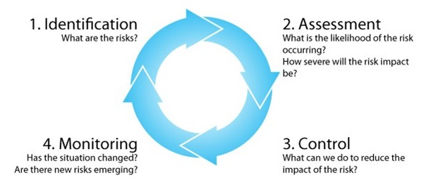
Occupational Health and Safety II
A Simplified Figure for Hazard Identification and Risk Assessment

Slide 15
Occupational Health and Safety II
Accident Investigation
Accident investigation is the process of determining the root causes of accidents, on-the-job injuries, property damage, and close calls in order to prevent them from occurring again.
Accident investigation will lead you to the real cause of why something happened, and armed with that knowledge, you can take affirmative steps to prevent future accidents from occurring.
Accident Investigation and Reporting

Slide 16
Occupational Health and Safety II
What is Required?
Develop an accident investigation process that focuses on:
Fact finding, not fault finding.
Determining the root causes of why the event occurred.
Making changes so the event does not happen again.
Set a policy that accidents and close calls (large and small) will be investigated with equal vigor.
Provide training and tools to staff conducting accident investigations.
Audit completed investigations to ensure they are being completed on a timely basis with an adequate level of detail.

Slide 17
Occupational Health and Safety II
How Do You Do It?
Workplace accidents should be investigated as soon as possible after they occur. The goals of a timely and thorough accident investigation should be to:
Determine the cause of the accident.
Prevent the accident from happening again.
Improve health and safety conditions in the workplace.
Determine whether a violation of federal or state safety and health standards contributed to the accident.
Determine company or individual liability in case of future legal action.
Determine the need for repairs or replacement of damaged items.
Determine the need for additional education and training for employees.

Slide 18
Occupational Health and Safety II
A thorough and complete accident investigation involves specifically the following steps:
Background investigation.
Site investigation.
Interviews.
Analysis and reporting.

Slide 19
Occupational Health and Safety II
Background investigation
Review the employment and injury records of any injured employee(s) and/or others whose actions contributed to the accident.
Review reports of any injuries and/or damage to equipment, machines, building, or property.
Compile a list of witnesses to the accident.
Gather information about normal conditions and/or operations of the area. Information would include maps, floor plans, wiring diagrams, and any other piping or architectural drawings or operational guidelines.
Meet with supervisors and other employees responsible for the affected area and employees of the affected area to outline the purpose and goals of the investigation. Ensure that there is a basic understanding of the materials, equipment, operation, or process involved.

Slide 20
Occupational Health and Safety II
Site investigation
Arrive at the scene of the accident as soon as possible after the incident has occurred.
Restrict the accident scene to authorized persons during the site investigation.
Ensure that movable evidence is secured to prevent tampering or other changes.
Determine what physical changes may have occurred following the accident. Changes could be attributed to clean-up, weather, maintenance, and normal usage.
Tour the entire area and record pertinent initial perceptions of the status and condition of building, grounds, equipment, lighting, and ventilation.
Sketch or draw parts of the accident scene where equipment or machinery involved in the accident is located or where actions that contributed to the accident occurred. Use the following guidelines when sketching or drawing an accident scene:
Use squared (graph) paper. If distance or size is important determine the value for each square and note this at the bottom of each sketch.
Orient each sketch with an arrow pointing north.
Label all objects.
Use arrows to indicate paths of travel of individuals and/or vehicles.
Indicate the distance of movable objects from two fixed locations.
Note the location of witnesses present at the time of the accident.
Take photographs of the overall scene, damaged areas, and pertinent machinery and/or equipment. Photographs should be made before any adjustments occur to the scene of the accident.
Prior to taking photographs, determine if the area has been altered. If items have been moved or changed, do not move them back for photographs. Photograph items as found, yet document the change and the individual responsible or knowledgeable of the
change.
For close-ups, use reference items such as a ruler or level measurer to indicate size or slope of the items photographed.
For each close-up, photograph the same item from a distance to provide a reference. Photograph the area where the
injured worker(s) were found, using reference marks to indicate individuals’ placement.

Slide 21
Occupational Health and Safety II
Interviews
Prepare a list of witnesses and other individuals to be interviewed.
When possible, do not allow more than 24 hours to elapse before conducting interviews.
Conduct interviews in a private setting to avoid interruptions and distractions.
Prepare a list of questions in advance of any interview. Use questions that require narrative answers. Avoid questions that suggest an expected answer (Example: “Isn’t it true that the injured employee was running?”) or that can be answered with either “yes” or “no.” Questions should be structured from the following six key elements: Who? What? Where? When? How? Why?
Who questions identify all parties involved.
What questions identify pertinent actions, events, and physical objects.
Where questions locate participants, witnesses, and key objects involved in the accident.
When questions determine the time of the accident and establish relationships between pairs of activities or events.
How questions provide information on the interaction and relationships among participants, equipment, and the events leading up to, during, and after the accident.
Why questions determine unsafe acts or hazardous conditions.
Before starting the interview, advise the person to be interviewed that the purpose of the session is to determine the cause of the accident and to prevent any future occurrence.
Start the interview by asking the individual to describe what happened. Do not interrupt with questions.
After the individual has given his or her initial statement, ask the prepared questions and any additional questions prompted by the individual’s statement.
Record the individual’s statement, the questions asked, and the answers received in the order that they occur. Let the individual talk, but not ramble. Interrupt when necessary to turn the conversation back to the subject at hand.
Close the interview when all questions have been answered and when the individual indicates no additional information can
be provided. Encourage the individual to contact you if other pertinent information comes to mind. Immediately after the
interview, review the individual’s statement and answers and record your impressions and judgments.

Slide 22
Occupational Health and Safety II
Analysis and reporting
After all fact-finding efforts are complete, analyze the data to determine all causes of the accident. Then prepare a comprehensive report outlining the identified causes and describing corrective measures to prevent similar future accidents. To best understand why an accident occurred and to plan for preventive actions, it is important to realize that most accidents have more than one cause. It is important to realize that an accident may be the result of the interaction of seemingly unrelated events.
Causes
The cause of an accident is any behavior, condition, act, or omission without which the accident may not have happened, or the severity of the injuries would have been less. Causes can be characterized as direct, indirect, or contributing.

Slide 23
Occupational Health and Safety II
Direct causes are acts or omissions that directly relate to the accident. These could include workers or other individuals who:
Operate equipment in an unsafe manner or operate equipment known to have safety defects or deficiencies.
Do not follow required or necessary safety precautions or procedures.
Fail to correct known damage to or faulty operations of equipment, machinery, or vehicles.
Indirect causes are conditions that directly contribute to the occurrence of a direct cause. These causes could include:
Defective or unusual conditions of equipment, machinery, vehicles, buildings, or grounds
Defective or unusual conditions of workers or other individuals, such as intoxication, physical defects or limitations, or psychological defects or limitations
Hazardous or unusual conditions of weather.
Contributing causes are conditions, programs, acts, or omissions that are not directly related to the accident but did contribute to the occurrence or existence of a direct or indirect cause. These causes could include lack of or inadequate:
Safety program.
Training programs.
Preventive maintenance programs.
Corrective maintenance programs.
Supervision.
Enforcement.
Design of equipment, machinery, vehicles, or facilities.
Advisory or warning communication, labels, or signs.

Slide 24
Occupational Health and Safety II
Analysis
Collect and correlate data. The following are examples of materials that can be used to ascertain all causes related to the accident. These materials should be collected and organized to allow investigators to review all information at one time:
Summary of employment and injury records of pertinent employees.
Summary of orientation and training records for pertinent employees.
Summary of normal conditions and/or operation of the pertinent area.
Description of usual and safe operations or use of materials, equipment, facilities, operations, or processes involved.
Summary of inspections of materials, equipment, and facilities involved.
Summary of witness statements that includes an outline of areas of agreement and disagreement between statements.
Summary of pertinent records of preventive maintenance or repair.
Written company policies or directives that pertain to the materials, equipment, facilities, operations, or processes involved.

Slide 25
Occupational Health and Safety II
Review data and pose hypothetical causes. The investigator should review all pertinent data. After the initial review, the investigator should outline potential direct, indirect, and contributing causes. It is important that all potential causes be listed and that the investigator not draw preliminary conclusions as to the probability that a potential cause was or was not related to the incident. It may be helpful to have a second individual conduct an independent review of the pertinent data to list all of the potential causes.
Test potential causes. Review again the pertinent data looking for specific data that affirm or reject each potential cause. Connect related direct, indirect, and contributing causes.

Slide 26
Occupational Health and Safety II
Reporting
A written report should be generated that contains the following sections:
Statement of the problem. This section should include:
A review of the incident.
A summary of injuries, lost time, and equipment and/or property damage.
Review of the data. This section should include:
A summary of witness statements.
A summary of relevant findings concerning the accident and work history of affected employees and the operation of machinery or equipment.
A storyboard with photographs or sketches.
An overview of existing, written company policies or directives.
Causes. This section should list the direct, indirect, and contributing causes that have been affirmed by the data. A reference should be made to the data that support each cause.
Recommendations. These should be based directly on each of the noted causes. These recommendations could include the following:
More or improved training for employees.
New company policies or directives, or better clarification or dissemination of existing ones.
Improved communication between employees, supervisors, and management.
Design or operation changes or improvements to machines, equipment, or processes.
Different or improved safety equipment.
Different or improved protection from natural phenomena or disasters.
Different or improved systems to account for possible physical, physiological, or psychological limitations of employees,
customers, or others.

Slide 27
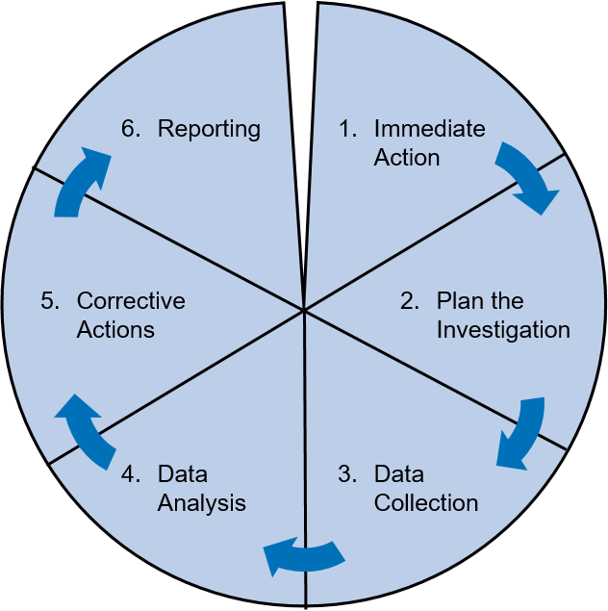
Occupational Health and Safety II
Six steps for successful accident investigation as defined by George Elton Mayo, one of the pioneers of business management:
Organizations investigate business upsets because they are required to by law or their own company standards, or the public or shareholders expect it. But, whatever the motivation, the goal is to identify why the incident happened and to take action to reduce the risk of future incidents.
Investigations often find that similar scenarios have occurred previously but, for a variety of reasons, did not result in serious consequences. This is increasingly recognized in high-risk industries where “near misses” are also investigated as well as incidents which actually resulted in loss.
A six-step, structured approach to incident investigation helps to ensure that all the causes are uncovered and addressed by appropriate actions.

Slide 28
Occupational Health and Safety II
Hazard Control
Effective controls protect workers from workplace hazards; help avoid injuries, illnesses, and incidents; minimize or eliminate safety and health risks; and help employers provide workers with safe and healthful working conditions. The processes described in this section will help employers prevent and control hazards identified in the previous section.
To effectively control and prevent hazards, employers should:
Involve workers, who often have the best understanding of the conditions that create hazards and insights into how they can be controlled.
Identify and evaluate options for controlling hazards, using a "hierarchy of controls."
Use a hazard control plan to guide the selection and implementation of controls, and implement controls according to the plan.
Develop plans with measures to protect workers during emergencies and nonroutine activities.
Evaluate the effectiveness of existing controls to determine whether they continue to provide protection, or whether different controls may be more effective. Review new technologies for their potential to be more protective, more reliable, or less costly.

Slide 29
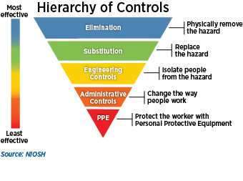
Occupational Health and Safety II
Action item 1: Identify control options
A wealth of information exists to help employers investigate options for controlling identified hazards. Before selecting any control options, it is essential to solicit workers' input on their feasibility and effectiveness.
How to accomplish it
Collect, organize, and review information with workers to determine what types of hazards may be present and which workers may be exposed or potentially exposed. Information available in the workplace may include:
Review sources such as OSHA standards and guidance, industry consensus standards, National Institute for Occupational Safety and Health (NIOSH) publications, manufacturers' literature, and engineering reports to identify potential control measures. Keep current on relevant information from trade or professional associations.
Investigate control measures used in other workplaces and determine whether they would be effective at your workplace.
Get input from workers who may be able to
suggest and evaluate solutions based on their
knowledge of the facility, equipment, and work
processes.

Slide 30
Occupational Health and Safety II
Action item 2: Select controls
Employers should select the controls that are the most feasible, effective, and permanent.
How to accomplish it
Eliminate or control all serious hazards (hazards that are causing or are likely to cause death or serious physical harm) immediately.
Use interim controls while you develop and implement longer-term solutions.
Select controls according to a hierarchy that emphasizes engineering solutions (including elimination or substitution) first, followed by safe work practices, administrative controls, and finally personal protective equipment.
Avoid selecting controls that may directly or indirectly introduce new hazards. Examples include exhausting contaminated air into occupied work spaces or using hearing protection that makes it difficult to hear backup alarms.
Review and discuss control options with workers to ensure that controls are feasible and effective.
Use a combination of control options when no single method fully protects workers.
Note: Whenever possible, select equipment, machinery, and materials that are inherently safer based on the application of "Prevention through Design" (PtD) principles. Apply PtD when making your own facility, equipment, or product design decisions.

Slide 31
Occupational Health and Safety II
Action item 3: Develop and update a hazard control plan
A hazard control plan describes how the selected controls will be implemented. An effective plan will address serious hazards first. Interim controls may be necessary, but the overall goal is to ensure effective long-term control of hazards. It is important to track progress toward completing the control plan and periodically (at least annually and when conditions, processes or equipment change) verify that controls remain effective.
How to accomplish it
List the hazards needing controls in order of priority.
Assign responsibility for installing or implementing the controls to a specific person or persons with the power or ability to implement the controls.
Establish a target completion date.
Plan how you will track progress toward completion.
Plan how you will verify the effectiveness of controls after they are installed or implemented.

Slide 32
Occupational Health and Safety II
Action item 4: Select controls to protect workers during nonroutine operations and emergencies
The hazard control plan should include provisions to protect workers during non-routine operations and foreseeable emergencies. Depending on your workplace, these could include fires and explosions; chemical releases; hazardous material spills; unplanned equipment shutdowns; infrequent maintenance activities; natural and weather disasters; workplace violence; terrorist or criminal attacks; disease outbreaks (e.g., pandemic influenza); or medical emergencies. Non-routine tasks, or tasks workers don't normally do, should be approached with particular caution. Prior to initiating such work, review job hazard analyses and job safety analyses with any workers involved and notify others about the nature of the work, work schedule, and any necessary precautions.
How to accomplish it
Develop procedures to control hazards that may arise during non-routine operations (e.g., removing machine guarding during maintenance and repair).
Develop or modify plans to control hazards that may arise in emergency situations.
Procure any equipment needed to control emergency related hazards.
Assign responsibilities for implementing the emergency plan.
Conduct emergency drills to ensure that procedures and equipment provide adequate protection during emergency situations.
Note: Depending on your location, type of business, and materials stored or used on site, authorities including local fire and emergency response departments, state agencies, the U.S. Environmental Protection Agency, the Department of Homeland Security, and OSHA may have additional requirements for emergency plans. Ensure that your procedures comply
with these requirements.

Slide 33
Occupational Health and Safety II
Action item 5: Implement selected controls in the workplace
Once hazard prevention and control measures have been identified, they should be implemented according to the hazard control plan.
How to accomplish it
Implement hazard control measures according to the priorities established in the hazard control plan.
When resources are limited, implement measures on a "worst-first" basis, according to the hazard ranking priorities (risk) established during hazard identification and assessment. (Note, however, that regardless of limited resources, employers have an obligation to protect workers from recognized, serious hazards.)
Promptly implement any measures that are easy and inexpensive (e.g., general housekeeping, removal of obvious tripping hazards such as electrical cords, basic lighting)regardless of the level of hazard they involve.

Slide 34
Occupational Health and Safety II
Action item 6: Follow up to confirm that controls are effective
To ensure that control measures are and remain effective, employers should track progress in implementing controls, inspect and evaluate controls once they are installed, and follow routine preventive maintenance practices.
How to accomplish it
Track progress and verify implementation by asking the following questions:
Have all control measures been implemented according to the hazard control plan?
Have engineering controls been properly installed and tested?
Have workers been appropriately trained so that they understand the controls, including how to operate engineering controls, safe work practices, and PPE use requirements?
Are controls being used correctly and consistently?
Conduct regular inspections (and industrial hygiene monitoring, if indicated) to confirm that engineering controls are operating as designed.
Evaluate control measures to determine if they are effective or need to be modified. Involve workers in the evaluation of the controls. If controls are not effective, identify, select, and implement further control measures that will provide adequate protection.
Confirm that work practices, administrative controls, and personal protective equipment use policies are being followed.
Conduct routine preventive maintenance of equipment, facilities, and controls to help prevent incidents due to equipment failure.

Slide 35
Occupational Health and Safety II
Fire Prevention & Suppression
The best defense against a fire is to prevent a fire from starting in the first place. Even under optimal circumstances, fires do occur. When prevention is compromised other timely and efficient mechanisms for response is critical to prevent injury and loss.
There are a number of things everybody can do to be well prepared for fire emergencies:
Be Prepared.
Know Exit Routes – Know exit routes from your workplace, the floor and the building in which it is located.
Know Fire Extinguisher Locations – Know where the closest fire extinguishers are located in proximity to your working area.
Emergency Numbers – Make sure you know your emergency numbers. It is recommended that emergency numbers be affixed to all telephones. Emergency numbers are posted in all work areas.
Review your Building Emergency Action Plan (BEAP).
Types of Fires
Fires are classified into 5 categories:
Class A Fires – Ordinary combustibles, paper, rags, wood products.
Class B Fires – Oil, flammable solvents, gasoline, and grease.
Class C Fires – Electrical and energized electrical equipment.
Class D Fires – Combustible Metals, magnesium, titanium, sodium, zirconium.
Class K Fires – Cooking Media.

Slide 36
Occupational Health and Safety II
Fire Prevention Plan
The Fire Prevention Plan is designed to inform employees about major fire hazards, what systems are available on the location to fight fires, and give notice of policies and procedures to follow to avoid fires.
Fire Detection Equipment:
Fire Alarm Systems: All systems should be tested and inspected semi-annually. They should be updated and tested for sensitivity as well as adequate sound levels (10db above ambient).
Smoke Detectors: Hard-wired smoke detectors should be located in almost all rooms. All battery backup-type detectors should be inspected semiannually along with all Fire Alarm Systems. Batteries should be changed in the detectors once a year.
Fire Suppression Equipment: The work area should be equipped with fire sprinkler suppression systems in some buildings. All suppression systems should be maintained in accordance with current codes by on-site staff who have been properly trained in the inspection, testing, and maintenance of those systems. They should be upgraded accordingly during renovation and remodeling. All fire extinguishers in workplace should be inspected monthly by in house personnel and serviced annually. Training must be held annually on proper usage of fire extinguishers.

Slide 37
Occupational Health and Safety II
Housekeeping Procedures for Managing Flammable and Combustible Waste Materials:
Good housekeeping is the most visible, day-to-day concern for Health and Safety. A sense of order in the living and working environments contribute to Health and Safety by minimizing obstacles and potential risks such as fire, spills, and trip hazards.
Means of Egress: Areas of egress, such as halls, doorways, passageways, stairwells, and corridors must remain clear of all obstructions.
Mechanical Rooms: Mechanical rooms must not be used for storage and must be clear of debris and other hazards.
Flammable Liquids: Flammable liquids should not be permitted inside any occupied building. This includes, but not limited to, gasoline, propane, kerosene, paint thinner, charcoal lighter, or any lighter fluid.
Chimneys and Fireplaces: There should not be any fireplaces used in workplace.
Fire Doors: A fire door serves as a barrier to limit the spread of fire and restrict movement of smoke. All doors leading into stairwells or hallways should be fire rated doors. Fire doors are self-latching and self-closing and must be maintained in proper working order. They must not be chained or propped open. They must always be free of wedges or blocking devices. Fire doors are rated between 20 minutes and 3 hours, this rating indicates how long the door assembly can withstand heat and, in some cases, the stream of a water hose.

Slide 38
Occupational Health and Safety II
Miscellaneous Fire Hazards and Devices: There are several devices that are restricted and prohibited for various reasons or require special indications or permission.
Candles: Candles are NOT permitted in any rooms or offices at any time.
Cooking: Hot plates, toasters, toaster ovens, microwaves, electric grills, and coffee pots are not permitted in residential rooms. Office areas may have a general area designated to be a break area with microwave, coffee pot, toasters, and toaster ovens. Designated office custodians are to check areas at the end of each day.
Portable (Space) Heaters: Open coil heaters are not permitted on campus. Closed loop, oil type are acceptable.
Incense, Potpourri, Glade Plug-In Style Air Fresheners, and Halogen Lamps: These items are not permitted in any campus building.
Light Fixtures: Nothing should ever be hung from any light fixture, nor should the light bulbs exceed the recommended wattage for the fixture.
Wall Outlets: Wall outlets should never be overloaded.
Hair Dryers: Small appliances should be used away from all water sources and shall have self-contained circuit interrupter. Curling irons, electric rollers, irons must be turned off when leaving the room.
Seasonal Decorations: Decorations made of paper or other flammable material are not permitted in campus buildings. All decorations made of combustible material including window curtains must have a flame-retardant application applied to it by the manufacture. This documentation must be retained.
Explosives/ Ordinance: Materials such as guns, ammunition, fireworks, black powder, and pyrodex are not permitted in any campus building.
Oil Lamps: Oil lamps are not permitted to be used or stored in campus buildings.
Sprinkler Heads/Pipes: Nothing may be hung from sprinkler pipes in any campus buildings with exposed systems. Nothing may be hung from sprinkler heads in any campus building at any time.
Extension Cords: The use of extension cords is for temporary functions and duties only. Types 12/2 are the only type to be used. No students or employees are to have any electrical cords of any kind under rugs. Surge protectors are the only acceptable devices for extension purposes. No cords with fractured insulation or exposed wires should ever be used and are to be discarded immediately.
Smoking: Smoking by employees or the public is prohibited in all buildings on campus, as well as all campus owned or leased vehicles. Smoking is permitted in specific areas on campus. E-Cig and Vaping Devices are considered the same as Smoking per this policy, and the same guidelines apply for those devices.
Fire Lanes: A fire lane is an area that is designated by a yellow or red painted curb and shall never be blocked or obstructed. Campus Police enforces
tickets and towing of vehicles in violation of this policy.
15. Fire Hydrants: Never park within 15 feet of a hydrant in any direction, as this may be subject to the same actions as Fire Lanes.

Slide 39
Occupational Health and Safety II
Fire Drills: It is important for employees to know how to react to a fire emergency when they occur. All buildings are subject to fire drills at any time. Fire drills are a proactive approach that allows employees to experience building evacuations under a controlled environment. It allows for workplace safety officials to identify problems that may occur under real life situations.
Responsibility: The Office of Emergency Management & Safety (OEMS) and the Department of Public Safety, have responsibility for the coordination, initiation, and response of Fire Drills.
Frequency: All workplaces should at least have 3 fire drills per year. OEMS has the authority to conduct additional drills if necessary.
Record keeping: Fire Drill reports will be recorded and reviewed for deficiencies. Problems will be identified, and appropriate action will be taken.

Slide 40
Occupational Health and Safety II
Fire Evacuation Plans and Procedures
Evacuation Floor Plan: Each floor of every building should have a legible and conspicuous emergency evacuation floor plan posted in view. These plans are usually located near exits or stairwells.
Emergency Numbers: Emergency Numbers should be posted for all occupants in plain view.
Exit Signs: All exits must be visibly marked. Exits that are not, could be confused for, or appear to be exits must be marked “Not an Exit”. Nothing may obstruct the visibility of these signs and they must be illuminated by a light source. All exit signs should be on emergency backup battery power and provide visibility in the event of a power outage or darkness.

Slide 41
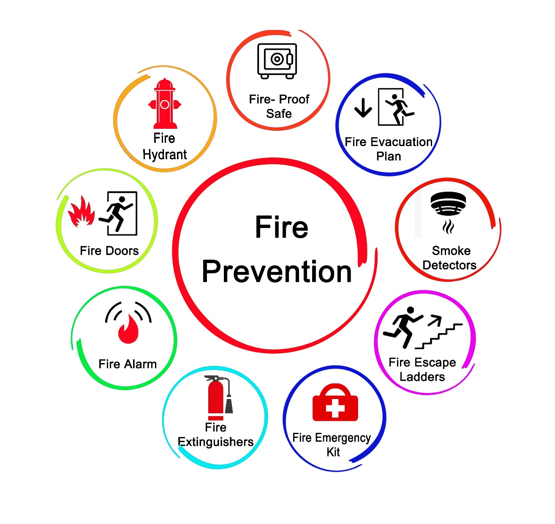
Occupational Health and Safety II
Emergency Response Guide – Fire Safety
In the event of a fire or the detection of smoke, a well-executed plan can minimize the threat to life and the extent of property damage. Fire and smoke are generally detected through personal observation or through smoke detector sensors. Fires are often caused by carelessness, equipment failure, and unfortunately arson, where someone may deliberately set the fire.
Fire is one of the most dangerous hazards due to the ease in which it can start and the devastating consequences that can result. The risk factors can be many; location and construction of the building, types of materials stored at the site, the surrounding environment, response of fire department personnel, and access to fire hydrants.

Slide 42
Occupational Health and Safety II
Action Checklist for Fire Safety
If fire is suspected, activate the alarm, immediately call fire department, alert others, and help remove anyone who needs assistance from the immediate danger of the fire or smoke.
Close all doors to confine and delay the spread of fire and smoke as much as possible.
When you hear the evacuation alarm, move to the nearest fire exit or fire exit staircase (do not use elevators).
Proceed to the designated evacuation assembly area outside the building unless directed to an alternate location.
If your clothing catches on fire, stop-drop-roll!
If you are trapped in a specific area, wedge wet clothing or towels under the door to keep out the smoke. Place a call to notify authorities of your location.
Never use the palm of your hand or fingers to test for heat. Burning your palm or fingers could hamper your ability to crawl or use a ladder for escape.
Be prepared; know where you are and where the exits to the outside are located. If heavy smoke is present, crouch low or crawl. Hold breath as long as possible or breathe through your nose using handkerchief or shirt as a filter.
If you have to move through flames, hold your breath, move as quickly as you can, cover your head, and stay low.
If fire is contained to a small area and if it is safe to do so, use a fire extinguisher; pull safety pin from handle, aim at base of fire, squeeze the trigger handle, and sweep from side to side.
Be familiar with how fire extinguisher operates.
Do not use water on an electrical fire. Use a fire extinguisher approved for electrical fires. Know where fire suppression equipment is maintained.
Smother oil and grease fires in a kitchen area with baking soda, salt or by putting a non-flammable lid over the flame.
If you cannot escape by a door or window, hang a white or light colored piece of clothing out the window to let
firefighters know your location.

Slide 43
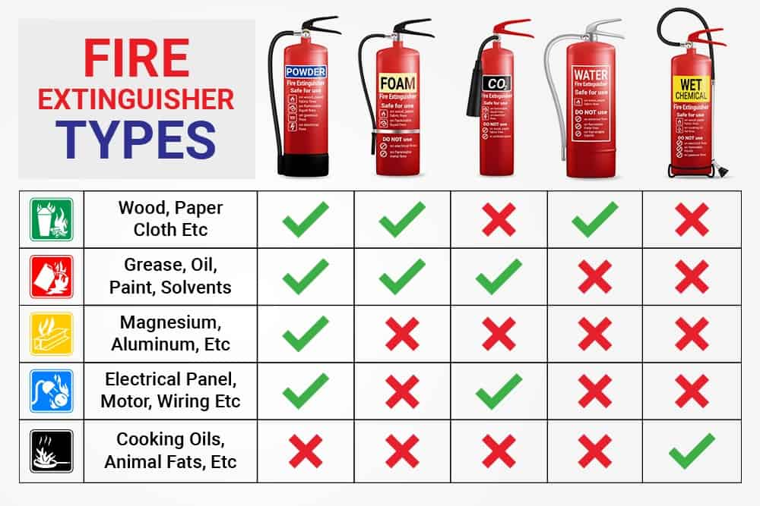
Occupational Health and Safety II
Portable Fire Extinguishers
An important part of fire safety is knowing where to find fire extinguishers and knowing how to use them if needed.
The purpose of fire extinguishers is to provide a first aid attack on any small incipient fire. Only trained employees should attempt to extinguish a fire. In no event should any person try to fight a fire with an extinguisher. It is designed to extinguish small kitchen type or trashcan fires.

Slide 44
Occupational Health and Safety II
Corporate Social Responsibility (CSR)
Business Benefits of Corporate Social Responsibility
Corporate social responsibility (CSR) has many advantages. These can apply to any business, regardless of its size or sector.
Benefits of corporate social investment for businesses
The potential benefits of CSR to companies include:
Better brand recognition
Positive business reputation
Increased sales and customer loyalty
Operational costs savings
Better financial performance
Greater ability to attract talent and retain staff
Organisational growth
Easier access to capital
Responsible business reputation
Corporate social investment can help you to build a reputation as a responsible business, which can, in
turn, lead to a competitive advantage. Companies often favor suppliers who have responsible policies,
since this can reflect on how their customers see them. Some customers don't just prefer to deal with responsible companies, they insist on it.

Slide 45
Occupational Health and Safety II
Costs savings
By reducing resource use, waste and emissions, you can help the environment and save money too. With a few simple steps, you may be able to lower your utility bills and achieve savings for your business. See how to reduce your business waste to save money.
Finding and keeping talented staff
Being a responsible, sustainable business may make it easier to recruit new employees or retain existing ones. Employees may be motivated to stay longer, thus reducing the costs and disruption of recruitment and retraining.
Other benefits of CSR to companies
By acting in a sustainable, responsible way, you may also find it easier to:
Access finance - investors are more likely to back a reputable business
Attract positive media attention - eg when taking part in community activities
Reduce regulatory burden - good relationships with local authorities can often make doing business easier
Identify new business opportunities - eg for the development of new products or services

Slide 46
Occupational Health and Safety II
Corporate Social Responsibility: Environmental Impact
Corporate social responsibility (CSR) can refer to a wide range of actions that businesses may take - from donating to charity to ethical trading. One primary focus of CSR is the environment.
Environmental CSR aims to reduce any damaging effects on the environment from your business processes. Activities may focus on:
Energy use
Water use
Waste management
Recycling
Emissions
Eco-friendly office and business travel policies
Some of these are significant from both environmental and financial points of view.

Slide 47
Occupational Health and Safety II
Advantages of environmental CSR
Green CSR can reduce business risk, improve reputation and provide opportunities for cost savings. Even the simplest energy efficiency measures can generate savings and make a difference to your business. For example:
Switching off lights and equipment when not in use
Reducing the use of water
Reducing the amount of paper you waste
Caring about the environment can increase revenue too. Many customers prefer to buy from responsible companies.
How to reduce your environmental impact
You can reduce your business’ environmental impact in many ways. For example, you can:
Create products that can be recycled
Optimise your product life cycle
Source responsibly (eg using recycled materials and sustainable timber)
Reduce packaging
Buy locally to save fuel costs
Create an efficient (and fuel-efficient) distribution network
Work with environmentally conscious suppliers and distributors

Slide 48
Occupational Health and Safety II
Corporate social responsibility: ethical trading
Ethical trading focuses on protecting workers' rights throughout the supply chain. By treating your employees, your suppliers and their workers fairly and ethically, you can demonstrate corporate social responsibility (CSR).
Ethical trade is about the purchasing practices of your business - and the steps you take to ensure that you and your supplier companies respect workers' rights.
The term ethical trading often implies socially responsible sourcing, which focuses on:
Worker welfare
Agricultural practice
Natural resource conservation
Sustainability

Slide 49
Occupational Health and Safety II
Ethical trade and suppliers Choosing your suppliers carefully can be an important part of your approach to CSR. For example, you might try to use local suppliers as much as possible. This helps you to support your local community and reduces the environmental impact of your sourcing, logistics and distribution practices. When choosing suppliers, you should also examine their: - Employment practices - Health and safety procedures - Environmental policies Customers are increasingly concerned about the wider impact of supply chains, for example on the local workforce and environment. Being associated with businesses that abuse the rights of their workers or their local environment can significantly harm your reputation. Larger organizations often audit their suppliers to ensure that they follow responsible working practices. You could do something similar, simply asking them about their attitudes to CSR might be revealing. You should also treat your suppliers fairly, particularly smaller businesses that rely on you. For example, on-time payments can make a big difference to them. | Ethical trade and customers Your customers will want to know that you don't exploit the people who make and sell your products. To reassure them, you could: - Create brochures in plain English and frankly disclose any 'small print‘ limitations. - Be open and honest about your products and services. Tell customers what they want to know, including what steps you take to be socially responsible. - If something goes wrong, acknowledge the problem and deal with it. In return, you can expect customers to reward you with their loyalty. Listening to your consumers can also help you improve the products and services you offer them.

Slide 50
Occupational Health and Safety II
Measure the effects of your corporate social responsibility
Many businesses have difficulties measuring the effect of their corporate social responsibility (CSR) initiatives. Some of the benefits such as customer loyalty and improved reputation are hard to quantify, making it difficult to assess the value of your activities.
However, measurement is extremely important as it enables you to:
Disclose the importance of your activities to your stakeholders and customers
Improve your decision-making as you move forward with your CSR programs
Align your activities with corporate goals, e.g. decrease turnover or develop staff skills
By measuring the impact of your CSR, you can connect the value of your activities to your company's bottom line. For example, you can establish a link between skill development and lower training costs, employee satisfaction and lower turnover rate, and even growth in sales leads that increases revenue.
How to measure the impact of your CSR?
Here are some ways to help you measure your CSR success. You can:
Compare your business to others - this is known as benchmarking.
Seek recognition for CSR best practice - eg take part in responsible business awards or use measurement tools such as the BITC’s Responsible Business Tracker.
Use key performance indicators (KPIs) to measure your environmental performance.
It's worth remembering that measurements will probably only show the immediate impact of CSR. The biggest
benefit can be the long-term improvement in your reputation

Slide 51
Occupational Health and Safety II
Importance of PR in corporate social responsibility
Corporate social responsibility (CSR) lends itself to good news stories and is a source of positive public relations (PR). Make the most of your CSR activities by publicizing them to let customers, suppliers and the local community know about the good that you are doing.
Role of PR in promoting your CSR
Publicity can be a key part of using CSR to win contracts. People want to buy from businesses they respect. CSR can be particularly effective for targeting ethical companies, the public sector and not-for-profit organizations. At the same time, you should see CSR as part of a continuing process of building long-term value. Everything you do should help improve your reputation and encourage customers and other stakeholders to stay involved with you. A business that buys recycled paper but exploits its customers and ignores the community has missed the point.
Business awards
Your business could also look at entering business awards that recognize and promote businesses that excel with corporate social responsibility projects.
Quality standards
You could consider working towards a management standard which you can then use to promote
your ethical, environmental or social responsibility. Socially responsible businesses act in an
ethical and transparent way that contributes to the health and welfare of society.

Slide 52
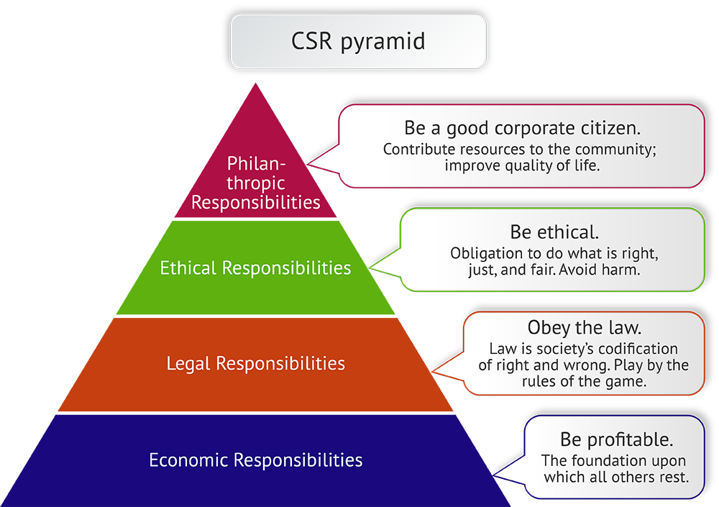
Occupational Health and Safety II

Slide 53
Occupational Health and Safety II
Motivating Safety Behaviors and Management Strategies
Many workers suffer nonfatal work-related injuries and still many workers die of fatal work-related injuries all over the World. Given these facts, employee safety continues to be a concern in organizations despite engineering advances that have reduced exposures over the past few decades. Many factors contribute to workplace safety. These include characteristics of the physical environment and human behavior within that environment. Human behavior on some level plays a role in the vast majority of workplace accidents and injuries. This can include risky behavior and signal detection failures, as well as a lack of proactive and collective safety behaviors that focus on changing the work environment to increase safety. Although several predictors of safety-related behavior have been identified, there are some unresolved issues with respect to safety performance in organizations.
What are some effective ways to motivate and reward safety behaviors and outcomes?
Set clear and realistic goals
Provide adequate training and resources
Create a positive safety culture
Offer meaningful incentives and rewards
Involve and empower the employees
Monitor and evaluate the results

Slide 54
Occupational Health and Safety II
Set clear and realistic goals
One of the first steps to motivate and reward safety behaviors and outcomes is to define what you expect from your employees and how you will measure their performance. You should set clear and realistic goals that are aligned with your organizational vision, values, and policies, and communicate them to your staff. You should also provide feedback and recognition for their achievements, as well as constructive guidance for improvement. By setting clear and realistic goals, you can help your employees understand the purpose and benefits of safety, and foster a sense of ownership and responsibility.
Provide adequate training and resources
Another way to motivate and reward safety behaviors and outcomes is to provide your employees with adequate training and resources to perform their tasks safely and efficiently. You should ensure that your staff have the necessary skills, knowledge, and competencies to identify and prevent hazards, follow safety procedures, and use protective equipment. You should also provide them with sufficient time, tools, and support to carry out their work without compromising their safety or quality. By providing adequate training and resources, you can help your employees develop confidence and competence in safety, and reduce the risk of errors, accidents, and injuries.

Slide 55
Occupational Health and Safety II
Create a positive safety culture
A third way to motivate and reward safety behaviors and outcomes is to create a positive culture that values and promotes safety as a priority and a shared responsibility. You should foster a culture of trust, cooperation, and communication among your employees, where they feel comfortable to report and address safety issues, learn from mistakes, and support each other. You should also encourage and reward positive safety behaviors, such as following rules, reporting hazards, suggesting improvements, and participating in safety activities. By creating a positive safety culture, you can help your employees develop a sense of belonging and pride in safety, and enhance their morale and motivation.
Offer meaningful incentives and rewards
A fourth way to motivate and reward safety behaviors and outcomes is to offer meaningful incentives and rewards that acknowledge and appreciate your employees' efforts and achievements in safety. You should design and implement a fair and transparent incentive and reward system that is based on objective and relevant criteria, such as safety performance, improvement, or innovation. You should also offer incentives and rewards that are meaningful and valuable to your employees, such as recognition, feedback, praise, certificates, bonuses, gifts, or opportunities. By offering meaningful incentives and rewards, you can help your employees feel valued and respected for their safety contributions, and stimulate their interest and enthusiasm in safety.

Slide 56
Occupational Health and Safety II
Involve and empower your employees
A fifth way to motivate and reward safety behaviors and outcomes is to involve and empower your employees in the planning, implementation, and evaluation of safety initiatives and programs. You should solicit and listen to your employees' opinions, suggestions, and feedback on safety matters, and involve them in decision-making and problem- solving processes. You should also empower your employees to take initiative, act proactively, and make decisions that enhance safety in their work areas. By involving and empowering your employees, you can help them feel engaged and committed to safety, and foster a sense of autonomy and accountability.
Monitor and evaluate the results
A sixth way to motivate and reward safety behaviors and outcomes is to monitor and evaluate the results of your safety efforts and interventions, and adjust them accordingly. You should collect and analyze data on safety indicators, such as incidents, near misses, inspections, audits, surveys, or observations, and use them to assess the effectiveness and impact of your safety strategies and actions. You should also share the results with your employees, and celebrate the successes, identify the gaps, and plan the improvements. By monitoring and evaluating the results, you can help your employees see the progress and outcomes of their safety behaviors, and reinforce their motivation and satisfaction.

Slide 57
Occupational Health and Safety II

Slide 58
Occupational Health and Safety II
A Case Discussion on O H & S : TURKEY
A Brief Background of the Case in the Country
Humanity has gone through great changes and made a mark in history. From the moment they started carving the first tools, they managed to transform life in different ways with the technology they created. While technology increased social welfare, it also posed a threat to humanity. One of these threats is deaths and accidents in working life.
Since the industrial revolution, the machines, buildings built, chemicals used and products produced have not only made life easier, but also caused work accidents to occur frequently. However, this situation is not limited to work accidents only; It also led to occupational diseases that threatened the health of many people. As the industry developed, concepts such as worker’s health and occupational safety have become threatening to human life. In fact, the concept of occupational safety dates back to ancient times and some early philosophers expressed some small awareness of this issue. As art and industry developed, awareness of work accidents and occupational diseases increased. With the transition from slave societies to capitalist systems, legal regulations began to be created in this field and these regulations were put into practice. Especially in regions such as Europe and America, occupational safety measures and practices have improved considerably. In Turkey, significant legal regulations generally began to take place after the establishment of the Republic.

Slide 59
Occupational Health and Safety II
When we look at the Republican period, the concept of occupational safety generally operated on the basis of the state's enactment and implementation of legal regulations. In Turkey, the influence of other countries put pressure on the enactment of legal regulations. As Turkey faced such pressures, she tried to make regulations in this field. However, the culture of occupational health and safety was never fully established.
During the Ottoman period, mine workers were exposed to harsh working conditions. Fatal accidents and collapses occurred frequently. In 1920, the country was going through a difficult period of independence war. The need for coal was great and working conditions were poor. These working conditions caused worker unrest especially in the Ereğli and Zonguldak coal basins. In 1921, the Turkish Grand National Assembly adopted a law regulating the law of mine workers. The Law named "Ereğli Havzai Fahmiyesi Maden İşçileri", numbered 151, adopted on September 10, 1921, prohibited people under the age of 18 from working in mines and limited the daily working time to 8 hours. It regulated that if workers worked beyond this period, they would be paid twice as much and that this overtime would be done with the consent of the parties. It also made it obligatory to ensure that workers who fell ill or had an accident were treated. Moreover, it made it mandatory to have hospitals, pharmacies and doctors around the mines. Considering the complexity of the period, we can say that a fairly advanced law was enacted under these conditions. Probably, the practices were not fully implemented at that time, but steps were taken to enact laws appropriate to the needs and the right decisions were made. It is not difficult to predict that it will take years for the law to be fully implemented.

Slide 60
Occupational Health and Safety II
In the same period, steps were continuing to be taken to determine workers' rights and ensure job security. In 1923, the Izmir Economic Congress was held and some decisions were taken to protect workers. This congress seemed to be held with the purpose of establishing a new economic order, recognizing the existence of workers and securing their rights. At the congress, it was decided to make regulations on issues such as workers' working conditions, working hours, union rights, protection of child workers, health conditions and working conditions of female workers. Although these issues seem more like workers' rights; occupational safety, worker health and general worker rights are a whole. Moreover, when we look at the country's agenda, clear laws regarding occupational health and safety have been enacted after many years. In the decisions taken regarding workers, occupational health and safety were mentioned with little emphasis. These concepts are also complex concepts. The social rights and security of the worker are an inseparable whole and intricate, it would not be right to see them as different from each other. To give a few simple examples, issues such as working hours, work conditions, lunches, work that children can do and their education, women's pregnancies and special situations are all related to both worker health and safety, as well as employee social rights and working conditions.

Slide 61
Occupational Health and Safety II
On the oyher hand, as a newly established country, Turkey did not have a cultural heritage regarding worker safety and rights from the previous Ottoman period. As all these deficiencies and problems were noticed or revealed, laws were passed and implemented. In this process, the living conditions of workers started to shape. There were provisions regarding occupational safety in the Code of Obligations No. 818 dated 1926. This article stated that the employer must take the necessary precautions against the dangers that the employee may encounter, and otherwise the employer is obliged to compensate for the damages suffered. This article, taken at that time, constitutes one of the important building blocks of the law to be enacted in the future for the purpose of occupational health and safety. Of course, the situation was not as messy and backward in Europe as it is in Turkey. In addition to workers' rights, Europe has addressed the concepts of occupational safety and health in a more detailed and autonomous manner. They are more focused on the details of these issues since they were introduced to industrialization and the problems it brought much earlier than Turkey. The International Labor Organization (ILO) was established on 11 April 1919. The ILO is an international organization that operates as part of the United Nations and aims to protect workers' rights, improve working conditions and promote workers' well-being. Countries such as the United States, European countries and Russia contributed to the establishment of the ILO. In these countries, the concept of working class has become widespread and the working class has been recognized. Turkey joined the ILO in 1932.

Slide 62
Occupational Health and Safety II
Moreover in Turkey, the General Health Law (Hıfzıssıhha Kanunu) was adopted in 1930 as a fundamental law for the purpose of protecting and improving public health in the Republic of Turkey. This law has become an important tool to prevent work accidents and occupational diseases by containing provisions regarding occupational safety. It contains the necessary regulations to ensure the health and safety of employees in workplaces. The law requires the presence of a physician in workplaces employing at least 50 workers and requires the establishment of an infirmary or hospital in workplaces of a certain size. It also includes articles prohibiting the employment of children under the age of 12 in factories and workshops. This law was effectively implemented in Turkey for many years and enabled large factories to have workplace physicians. As can be seen from the process, both workers' rights and occupational safety and worker health issues were making progress, but the momentum was quite low. In fact, Occupational Health and Safety (OHS) is an area that has always progressed slowly in Turkey and has lagged behind some developments. 1936 is the year when Law No. 3008, the first labor law in the country, was adopted. With this law, workers were officially recognized and a law regulating workers' rights was implemented. Labor laws have been amended and updated several times over time. An important aspect of these laws is that some of the concepts of occupational health and occupational safety are included in these laws. For years, occupational health and safety rules have been added to these labor laws and these rules have been put into practice. Employers are obliged to take the necessary measures to ensure the health and safety of their employees in their workplaces. Likewise, workers were forced to comply with occupational health and safety rules. However, as of today, issues such as creating systematic occupational safety rules or applying these rules as needed are still not fully developed.

Slide 63
Occupational Health and Safety II
Turkey's becoming a member of the International Labor Organization (ILO) in 1932 is an important turning point. Turkey's membership in the ILO can be considered as part of efforts to comply with international occupational health and safety standards. Over time, Turkey will also sign ILO conventions. The Ministry of Labor was established in 1945. It is estimated that there were approximately 2.5 million workers in Turkey then. During this period, the "General Directorate of Occupational Health" was also established and this directorate was determined as an institution that would work in the field of occupational safety. The General Directorate of Occupational Health and Safety (ISGM), which is still active today, works on preventing work accidents and occupational diseases and on the occupational health and safety of employees. During the establishment of the Ministry of Labor, some laws that were important for workers were also adopted. The establishment of the Workers' Insurance Institution No. 4792 in 1945 and the subsequent adoption of the Work Accidents, Occupational Diseases and Maternity Insurance Law No. 4772 were considered important steps in workers' rights and occupational safety. These laws are efforts to protect the social rights and health of workers. However, statistics on work accidents were not kept very well at that time. According to the data obtained, more than 300 people lost their lives in the mining accident that occurred in Zonguldak in 1914. More than 100 people lost their lives in Zonguldak in 1943, and more than 100 people died in the same region in 1945. These are tragic accidents that occurred in coal mines. Additionally, work accidents in factories were also noteworthy. More than 200 people died in a fire in a factory in Istanbul in 1917, more than 100 people died in an explosion in a factory in Izmir in 1927, and more than 50 people died in a collapse in a construction site in Ankara in 1934. Although the number of major work accidents is quite high, the measures taken were not very encouraging.

Slide 64
Occupational Health and Safety II
Until 1945, there were approximately 10,000 factories in Turkey. During this period, approximately 1 million factories were operating in Germany. This difference was due to the fact that Turkey's industrialization process started later than Germany. Germany started its industrialization process in the late 18th century, whereas Turkey started its industrialization journey towards the end of the 19th century. According to the development status of the industry, the concept of occupational health and safety also developed and became used in the country. Social Insurance Law No. 506 is a law that forms the basis of the social security system in Turkey. This law was accepted on July 13, 1964 and came into force in 1965. Its main purpose is to provide social security to employees, retirees and their families. In other words, it aims to ensure that workers have social security for situations such as retirement, illness, work accident and birth. In this way, employees in Turkey have the opportunity to protect themselves and their families in various living conditions. In 1974, the publication of Occupational Health and Safety Regulation No. 178 constituted an important turning point in the field of occupational health and safety in Turkey. This regulation has served as a great resource with the technical details and explanations it contains. A commission consisting of employers, workers, labor unions, occupational health and safety experts and academicians took part in the preparation of the regulation. This commission has prepared a resource on occupational health and safety practices in Turkey by carefully examining the relevant conventions, recommendations and international standards of the International Labor Organization (ILO). This charter is very comprehensive and professionally written. Providing clear information in the field of occupational health and safety has made this regulation extremely valuable for users. It has a more concrete and understandable approach compared to today's regulations, and has brought clearer concrete suggestions by reducing the complexity on occupational health and safety issues. Unfortunately, this statute was later repealed.

Slide 65
Occupational Health and Safety II
Labor Law No. 931, enacted in 1967, stands out as an important law regulating employee and employer relations in Turkey. However, changing needs and economic conditions over time have required this law to be amended several times. In 1971, the Constitutional Court annulled the Labor Law No. 931 due to some formal problems. Following this development, Labor Law No. 1475 came into force and included various regulations regarding employee and employer rights. In 2003, during Turkey's harmonization process with the European Union, Labor Law No. 4857 was adopted. This law included many regulations strengthening the rights of workers and also included important regulations on occupational health and safety. The social movement had a great impact on legal changes in the 1970s. The Constitutional Court's annulment of the Labor Law No. 931 in 1971 was due to the influence of labor movements. Workers in Turkey have expressed their demands such as improving working conditions, increasing wages and strengthening union rights. Labor Law No. 931 created a balance in favor of employers and did not adequately protect the rights of workers. The decision of the Constitutional Court was an important step taken in line with the determination and demands of the labor movements and accelerated the developments in workers' rights. Labor Law No. 4857 is an important law in Turkey that regulates issues such as worker rights, employer relations and occupational health. It is also the basic law of the Social Security Institution (SSI - SGK) in working life. This law covers many issues such as workers' working conditions, salaries, leave rights and occupational health and safety. The functioning of SSI is also determined by this law. Many regulations were issued with the Labor Law No. 4857. Among these regulations, there are many important regulations such as the Occupational Health and Safety Regulation, the Regulation on Health and Safety in Construction Works, the Regulation on the Protection of Employees from the Dangers of Explosive Environments, the Regulation on Health and Safety Measures in Working with Chemical Substances, and the Regulation on Health and Safety Measures in Working with Asbestos. However, since they are quoted from European Union norms, some of them are difficult to understand. These regulations are still valid and
usable and are updated from time to time. However, the regulations were not well implemented when they first
came into force.

Slide 66
Occupational Health and Safety II
According to TÜİK data, the rates of work accidents and occupational diseases in Turkey have decreased significantly since 1945. While there were 20.9 work accidents per 100000 employees in 1945, this rate decreased to 2.1 in 2022. While there were 10.2 work accidents per 100000 employees in 2003, this rate has also decreased over time. TurkStat publishes these statistics from time to time, and these data contribute to the monitoring of occupational health and safety policies. Undertaking a similar task with TÜİK, the İSİG (İşçi Sağlığı ve İş Güvenliği) Assembly started working in Istanbul in 2011 and later continued its work in different regions such as Kocaeli, Ankara, İzmir and Diyarbakır. This council, which is an important alternative source on occupational safety, emerged as a community of volunteers. The OSH Assembly is an organization formed by a wide network of workers from different sectors, branches and professions, as well as workers' families. This formation, which defines itself as the "Occupational Health and Occupational Safety Assembly", has been carrying out studies on occupational safety issues by bringing together participants from various segments since 2011. While this process progresses in Turkey, the world and especially European countries have developed their occupational safety practices much more. The International Labor Organization (ILO) has pioneered this issue and published 190 conventions and 190 recommendations. ILO recommendations provide guidance and suggestions to member countries to improve working conditions and protect workers' rights. These recommendations have created a resource for member countries to regulate their national laws. Some of these agreements and recommendations include:
Principles of Anti-Discrimination (Article 2 and Article 4): The ILO promotes the fight against race, sex, religion, national origin and other forms of discrimination and supports the principle of equality at work.
Articles Against Child Labor (Article 4 and Article 5): ILO aims to combat child labor and protect the education and development of children. Promotes the prohibition and elimination of child labor.
Occupational Health and Safety (Article 4 and Article 5): ILO promotes occupational health and safety measures in workplaces and establishes standards to ensure the safety of workers.
These articles have been in practice in Europe for a long time, Turkey has signed and accepted these and many other articles,
but the implementation process is quite new. While the practices in Europe are established, Turkey's compliance with
these standards is still new.

Slide 67
Occupational Health and Safety II
The European Union (EU) implements occupational health and safety policies through the European Union Occupational Health and Safety Directives. There is a significant decrease in the rates of work accidents and occupational diseases compared to the past. While there were 15.5 work accidents per 100000 employees in the EU in 1995, this rate decreased to 2.9 in 2020. Likewise, in Europe, while the number of workers dying from occupational diseases was 37000 in 1995, it decreased to 13000 in 2020. These statistics show that occupational health and safety measures are effectively implemented in Europe. In 2012, due to the pressure of the European Union and the International Labor Organization and the costs of work accidents to the country, occupational health and safety practices began in Turkey. During this period, Occupational Health and Safety Law No. 6331 came into force. This law covers occupational health and safety regulations in a more comprehensive and detailed manner. It regulates all issues related to ensuring occupational health and safety, and the regulations under the Labor Law No. 4857 have begun to be implemented as sub-regulations of this law. In this way, a holistic resource in the field of occupational health and safety was created. During this period, first of all, risk assessments were made in workplaces in the country and companies of many different sizes had this report prepared. However, most companies thought that their responsibility for occupational safety ended with this step. Later, workplaces began to be visited by occupational safety inspectors and occupational physicians. These steps enabled occupational health and safety issues to be addressed more effectively in the country. The implementation of the Occupational Health and Safety Law No. 6331 adopts a proactive approach. The proactive approach is said to involve proactively identifying risks and hazards before adverse events occur, eliminating these risks, and training workers. During this period, efforts are being made to implement Occupational Health and Safety (OHS) practices more effectively in the country. Occupational safety inspectors and workplace physicians played a fundamental role in this process. In particular, the area of responsibility of occupational safety experts is quite wide. They are at war in many areas, from assessing risks in the workplace to the use of personal protective equipment, from emergencies to convincing workers and employers. Again, occupational physicians actively work in the field in the diagnosis and treatment of occupational diseases
and work-related diseases. Inspectors and physicians need to make intense efforts to ensure the effectiveness of OSH practices,
because all the burden is on them.

Slide 68
Occupational Health and Safety II
We have miners working underground in our country. In 2022, Turkey became the country in Europe by producing 105 million tons of coal with a share of approximately 33%. While the world is abandoning coal, Turkey still uses this resource intensively. However, occupational safety in mines poses a very serious problem. Unfortunately, mines still lack adequate ventilation, electrical systems are not installed properly, and gas detectors do not work properly. The deficiencies mentioned are basic deficiencies. Due to these basic deficiencies, collapses and explosions occur underground and mass casualties occur. Turkey ranks first in Europe with a rate of 2.8 fatal work accidents per 100000 employees in the construction industry. For example, in Germany, the rate of fatal work accidents per 100000 employees is 0.8, that is, approximately one-third of the rate in Turkey. This situation is caused by occupational accidents due to reasons such as not taking adequate precautions for the safety of workers, not installing proper scaffolding, not using life ropes, not arranging electrical parts properly and not using proper equipment. Although the situation is better in the factories, there are many problems there too. Corporate ones are relatively better, because they know that paying attention to occupational safety will also increase production. However, even in factories, occupational safety practices are not sufficient. It is much more difficult to get work done by small workshops. While the rate of fatal occupational accidents per 100000 employees in factories in Europe is 0.9, in Turkey this rate is recorded as 1.9 in factories. Occupational safety is a seriously problematic issue all over our country. Occupational safety should be an integral part of business life in the future. Technological developments can offer great advantages in the field of occupational safety. In particular, artificial intelligence, robots and automated machines can be used instead of humans in dangerous jobs, so that human life is not put at risk. Today, the use of technological equipment and machines creates a safer working environment in terms of occupational safety. Older types of machines and tools can pose more danger to workers. Therefore, technological advances are of great importance in terms of occupational safety and will contribute to further raising occupational safety standards in the future. Many jobs are still done by human power in Turkey. In fact, Law No. 6331 had positive effects throughout the country. This law is a good resource on occupational safety. If these laws and regulations could be effectively implemented as written, the country would become one of the safest countries in Europe. However, unfortunately, the application cannot be implemented as written. In 2024, there is still no established occupational safety culture in the country. The actors (Occupational Safety inspectors and Doctors) are still in the field, making efforts to create this culture. However, the problem cannot be solved with these actors alone. Merely passing legislation
does not solve the problem. In 2024, there is still no established occupational safety culture in the country.

Slide 69
Occupational Health and Safety II
Occupational Health and Safety Data for Turkey between 1998 and 2014

Slide 70
Occupational Health and Safety II
Related Legislation in Turkey
The Constitution
The Constitution in Turkey has been revised several times, most recently in 1982. There are up to 20 Articles in the Constitution regulating various areas of working life; i.e., the right and responsibility to work, organizing unions, right to social security, etc. The Articles related to working life play a central role in protecting the labor force, ensuring proper placement of the workers and providing a safe working environment. Two of the Articles directly concern occupational safety and health:
Article 50 - “No one can be employed at the workplaces not suitable for their age, gender and capacity. Children, women and the disabled are protected by Law”.
Article 56 - “Everyone has the right to live in a healthy and balanced environment”.
The Constitution refers to the environment in general, nevertheless based on these articles, the working environment should be “safe and healthy”.

Slide 71
Occupational Health and Safety II
Occupational Safety and Health Law (No. 6331; 2012)
The Occupational Safety and Health Law (No. 6331; 2012 (OSH Law) was published in the Official Gazette in 2012. Before 2012, occupational safety and health issues were regulated in the Labor Law, related regulations and some other general laws. The OSH Law applies to all jobs and workplaces in both the public and private sector, regardless of their field of activities or number of workers, and covers all employees, interns, employers and their representatives. The Turkish Armed Forces, the Police Department and specific activities in civil defence services are not covered by the OSH Law. Furthermore, the OSH Law does not apply to domestic services, persons producing goods and services in their own name and on their own account, prisons and similar institutions. The OSH Law regulates the duties, authority, responsibilities, rights and obligations of employers and employees in order to ensure occupational safety and health in the workplace and to improve the existing safety and health conditions. The ultimate aim of the OSH Law is to prevent occupational diseases and accidents, and other physical and mental health problems of the workers related to work and the work environment. The OSH Law defines the main stakeholders namely employees, employers and the State, and their duties and responsibilities in working life. The Law also defines the basic terminology related to work life such as workplace, hazard, risk, occupational disease, occupational accident, prevention, safety and health unit, occupational safety and health professionals and their responsibilities. According to the OSH Law, the employer should perform risk assessment and has the responsibility of taking all necessary measures to ensure occupational safety and health.

Slide 72
Occupational Health and Safety II
Therefore the employer shall fulfil the responsibility of avoiding risks, evaluating risks which cannot be avoided, combating the risk at its source, adapting the work and working conditions to the individual, adapting to technical progress, substituting dangerous substances or procedures with a non-dangerous or less dangerous ones, provide appropriate training and instructions to the workers, etc. Article 4 of the Law defines the duties, authority and responsibilities of the employer and workers. As per Article 4, the employer has a duty to ensure the safety and health of workers in every aspect related to work. In this respect the employer shall take the measures necessary for safety and health protection of workers, including provision of necessary organization, designating safety and health staff, informing and training of workers, carrying out risk assessment, implementing measures related to occupational safety and health in accordance with the legislation, etc. In case an employer enlists competent external services or persons, this shall not discharge him from his responsibilities in this area. Also the workers’ obligations in the field of safety and health at work shall not affect the principle of the responsibility of the employer. As indicated in Article 6 of the Law, in order to provide occupational safety and health services the employer shall designate workers as occupational safety expert, occupational physician and other health staff, meet the need for means of space and time to help designated people or organizations fulfil their duties, ensure cooperation and coordination among the occupational safety and health staff, etc. The OSH Law also regulates workers’ right to abstain from work in cases of serious or imminent danger. The OSH Law refers to secondary legislation to for a description of further details to ensure an effective implementation of the Law. Although the OSH Law covers civil servants as well; the obligation of recruiting occupational physicians and occupational safety inspectors in the public sector was postponed until 01/07/2016 in accordance with the Law no. 6495 dated 12/07/2013.

Slide 73
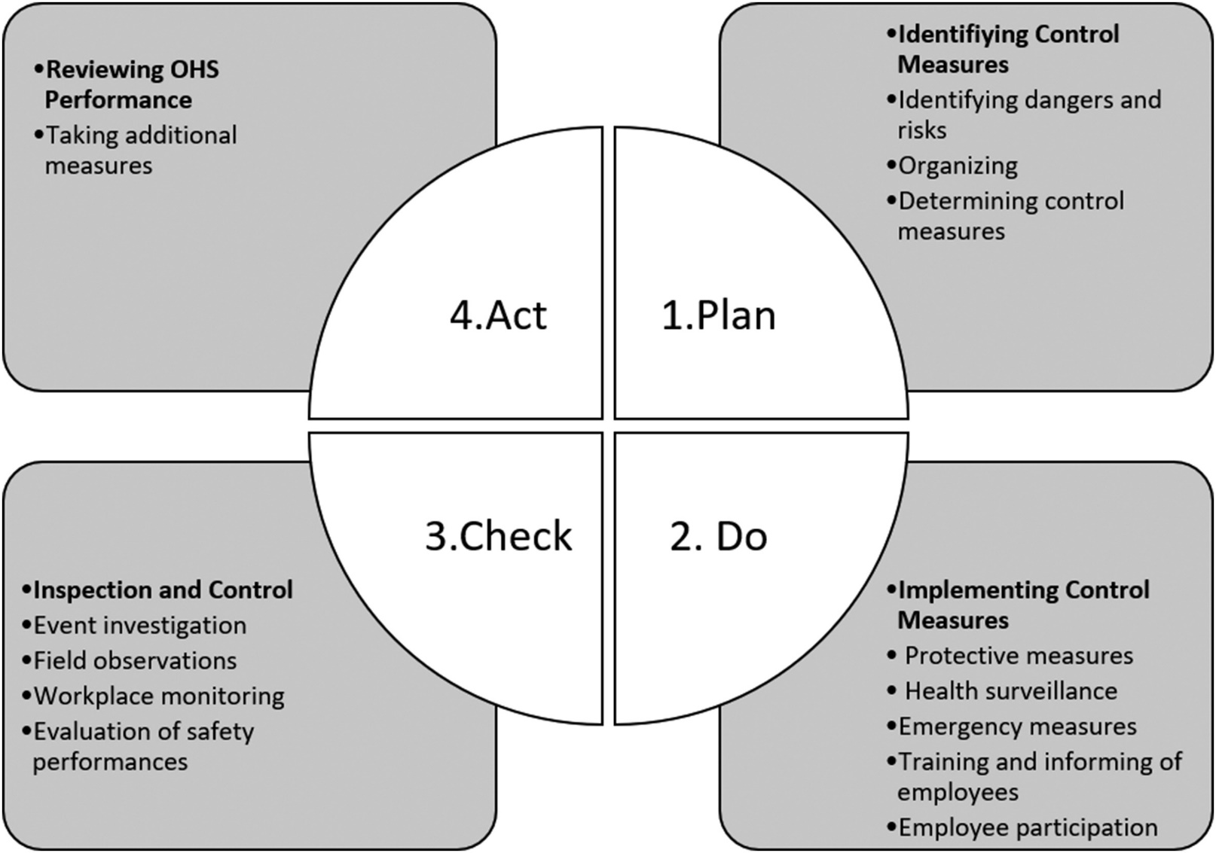
Occupational Health and Safety II
Adaptation of Obligations of the Occupational Health and Safety Law no 6331 to PDCA (Plan-Do-Check-Act) Methodology

Slide 74
Occupational Health and Safety II

Slide 75
Occupational Health and Safety II

Slide 76
Occupational Health and Safety II

Slide 77
Occupational Health and Safety II

Slide 78
Occupational Health and Safety II

Slide 79
Occupational Health and Safety II

Slide 80
Occupational Health and Safety II

Slide 81
Occupational Health and Safety II

Slide 82
Occupational Health and Safety II

Slide 83
Occupational Health and Safety II

Slide 84
Occupational Health and Safety II

Slide 85
Occupational Health and Safety II

Slide 86
Occupational Health and Safety II

Slide 87
Occupational Health and Safety II

Slide 88
Occupational Health and Safety II

Slide 89
Occupational Health and Safety II

Slide 90
Occupational Health and Safety II

Slide 91
Occupational Health and Safety II

Slide 92
Occupational Health and Safety II

Slide 93
Occupational Health and Safety II

Slide 94
Occupational Health and Safety II

Slide 95
Occupational Health and Safety II

Slide 96
Occupational Health and Safety II

Slide 97
Occupational Health and Safety II

Slide 98
Occupational Health and Safety II

Slide 99
Occupational Health and Safety II

Slide 100
Occupational Health and Safety II

Slide 101
Occupational Health and Safety II

Slide 102
Occupational Health and Safety II

